Slide 1
Neuromorphic Computing & Hardware L4: SNN Training
Intelli-Chip Lab
Fall 2026

Slide 2
Objectives
After this lecture, students should be able to:
✓ Understand surrogate-gradient training
✓ Recognize tradeoffs between accuracy, latency and hardware efficiency

Slide 3
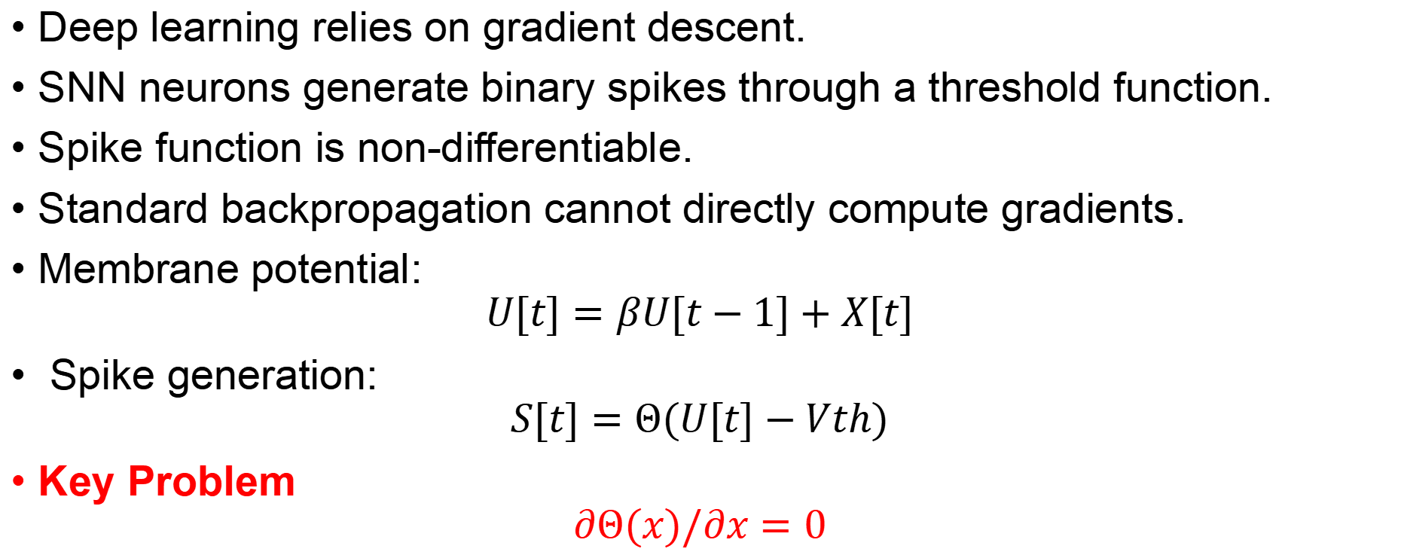
SNN Training Challenge
Deep learning relies on gradient descent.
SNN neurons generate binary spikes through a threshold function.
Spike function is non-differentiable.
Standard backpropagation cannot directly compute gradients.
Membrane potential:
$$U[t]=βU[t−1]+X[t]$$
Spike generation:
$$S[t]=Θ(U[t]−Vth)$$
Key Problem
$$∂Θ(x)/∂x=0$$

Slide 4
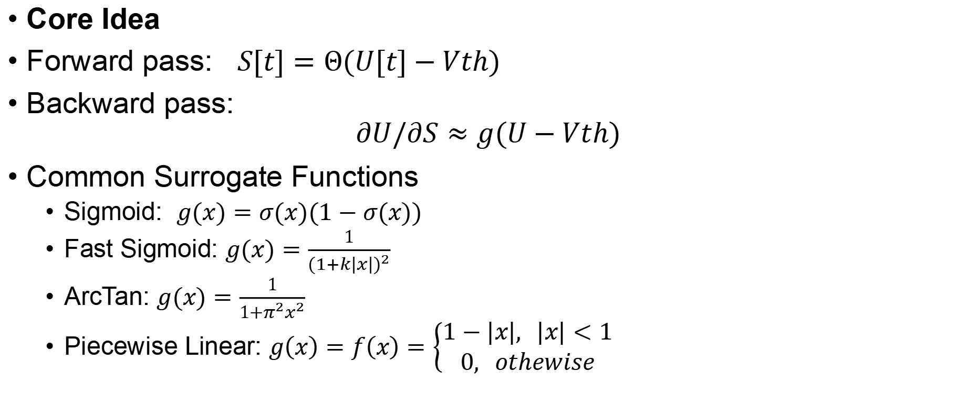
Surrogate Gradient Learning
Core Idea
Forward pass: $S[t]=Θ(U[t]−Vth)$
Backward pass:
$$∂U/∂S​≈g(U−Vth​)$$
Common Surrogate Functions
Sigmoid: $g(x)=σ(x)(1−σ(x))$
Fast Sigmoid: $g(x)=\frac{1}{{(1+k|x|)}^{2}}$
ArcTan: $g(x)=\frac{1}{1+π^{2}x^{2}}$
Piecewise Linear: $g\left(x\right)=f\left(x\right)=\left\{\begin{aligned}1−|&x|, |x|<1 \\ &0, othewise\end{aligned}\right.$
Notes:
replace the derivative of the step function with a smooth approximation
Key Insight
Forward pass remains biologically plausible.
Backward pass becomes differentiable.
Enables gradient-based optimization.

Slide 5

Sigmoid Surrogate Example
$$σ\left(x\right)=\frac{1}{1+e^{−αx}}$$
$$σ^{′}\left(x\right)=\frac{α∙e^{−αx}}{{\left(1+e^{−αx}\right)}^{2}}$$
Notes:
α 是控制曲线陡峭程度的超参数
通过调节α，模型可以在梯度的
准确性与传播的有效性之间取得平衡，从而实现SNN 的高性能训练。

Slide 6
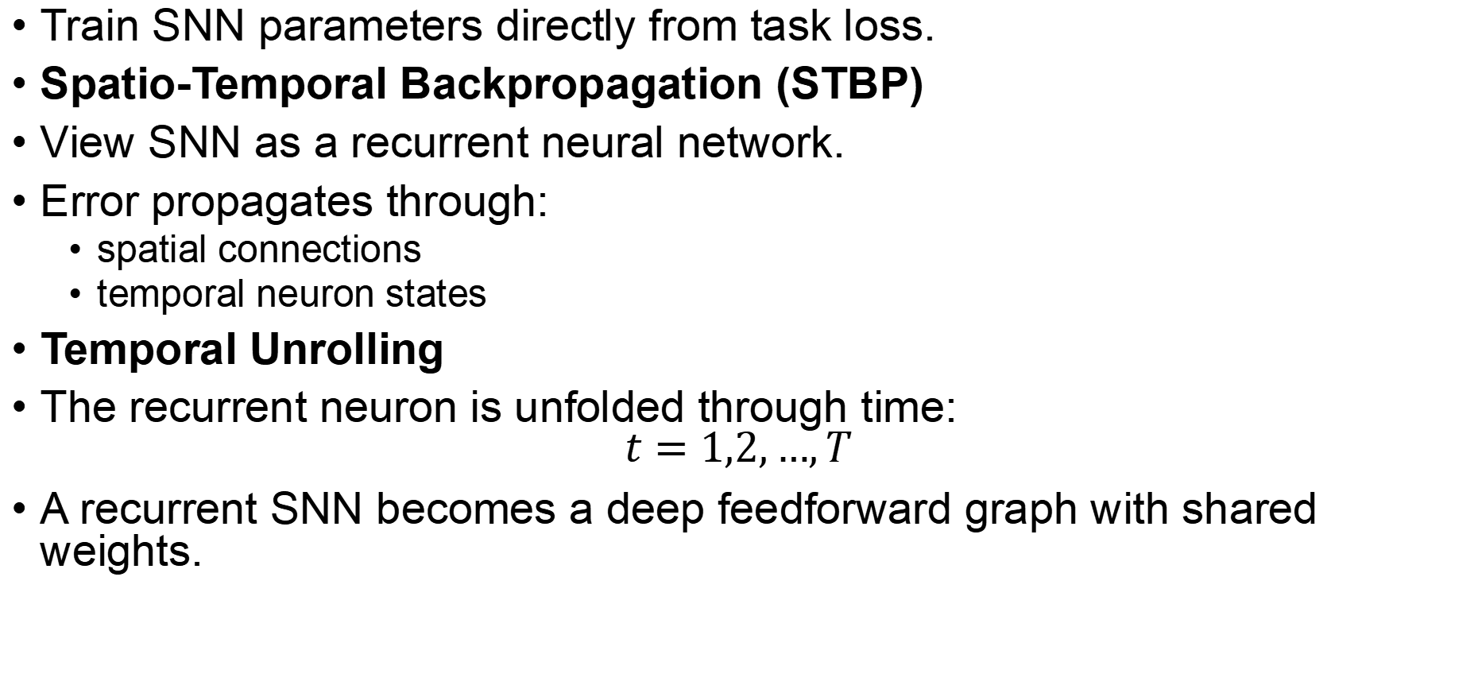
Direct SNN Training via STBP
Train SNN parameters directly from task loss.
Spatio-Temporal Backpropagation (STBP)
View SNN as a recurrent neural network.
Error propagates through:
spatial connections
temporal neuron states
Temporal Unrolling
The recurrent neuron is unfolded through time:
$$t=1,2,…,T$$
A recurrent SNN becomes a deep feedforward graph with shared weights.

Slide 7
Backpropagation Through Time (BPTT)
Unroll the network over time and accumulate gradients

Slide 8
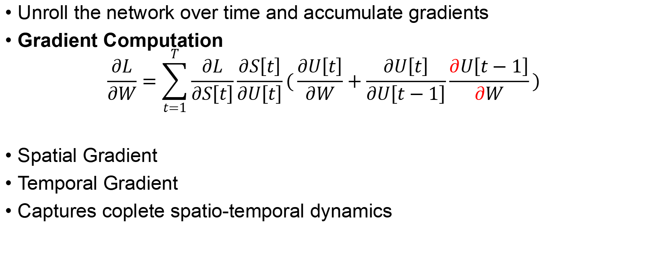
Backpropagation Through Time (BPTT)
Unroll the network over time and accumulate gradients
Gradient Computation
$$\frac{∂L}{∂W}=\sum_{t=1}^{T}{\frac{∂L}{∂S\left[t\right]}\frac{∂S\left[t\right]}{∂U\left[t\right]}}(\frac{∂U\left[t\right]}{∂W}+\frac{∂U\left[t\right]}{∂U\left[t−1\right]}\frac{∂U\left[t−1\right]}{∂W})$$
Spatial Gradient
Temporal Gradient
Captures coplete spatio-temporal dynamics

Slide 9
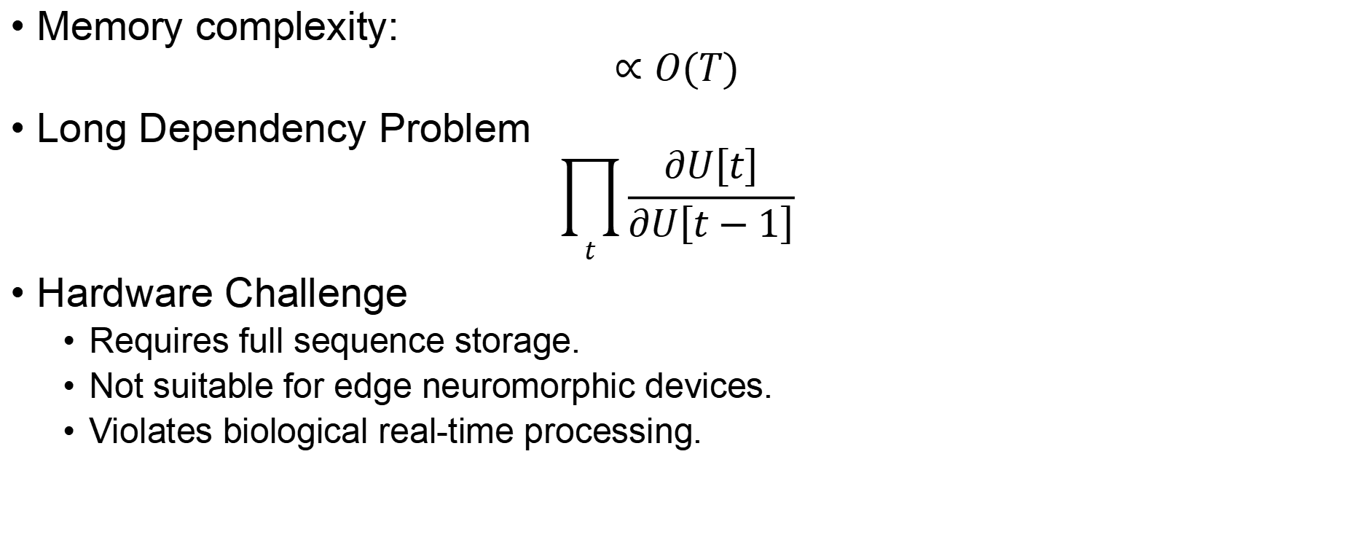
Limitations of BPTT
Memory complexity:
$$∝O(T)$$
Long Dependency Problem
$$\prod_{t}{\frac{∂U\left[t\right]}{∂U\left[t−1\right]}}$$
Hardware Challenge
Requires full sequence storage.
Not suitable for edge neuromorphic devices.
Violates biological real-time processing.
Notes:
To compute gradients:
✓ Store membrane potentials
✓ Store spikes
✓ Store computation graph
for every timestep.
Temporal dependencies are coupled across all timesteps. may cause:
vanishing gradients
exploding gradients

Slide 10
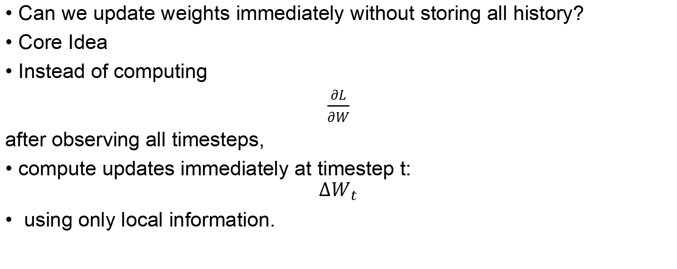
Online Learning for SNNs
Can we update weights immediately without storing all history?
Core Idea
Instead of computing
$\frac{∂L}{∂W}$
after observing all timesteps,
compute updates immediately at timestep t:
$$ΔW_{t}$$
using only local information.
Notes:
Use only local information:

Slide 11
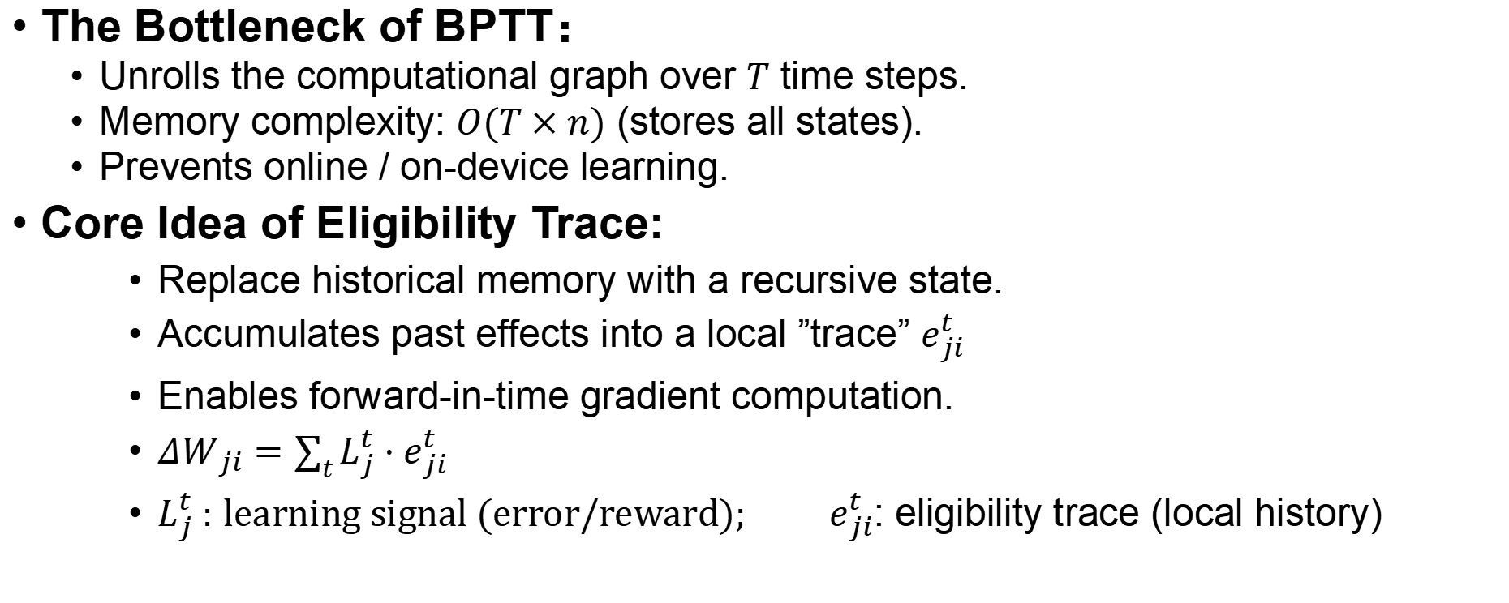
Eligibility Trace: Replacing BPTT Memory
The Bottleneck of BPTT：
Unrolls the computational graph over $T$ time steps.
Memory complexity: $O(T×n)$ (stores all states).
Prevents online / on-device learning.
Core Idea of Eligibility Trace:
Replace historical memory with a recursive state.
Accumulates past effects into a local ”trace” $e_{ji}^{t}$
Enables forward-in-time gradient computation.
$ΔW_{ji}=\sum_{t}{L_{j}^{t}}⋅e_{ji}^{t}$
$L_{j}^{t} :$ $learning signal (error/reward);$ $e_{ji}^{t}$: eligibility trace (local history)

Slide 12
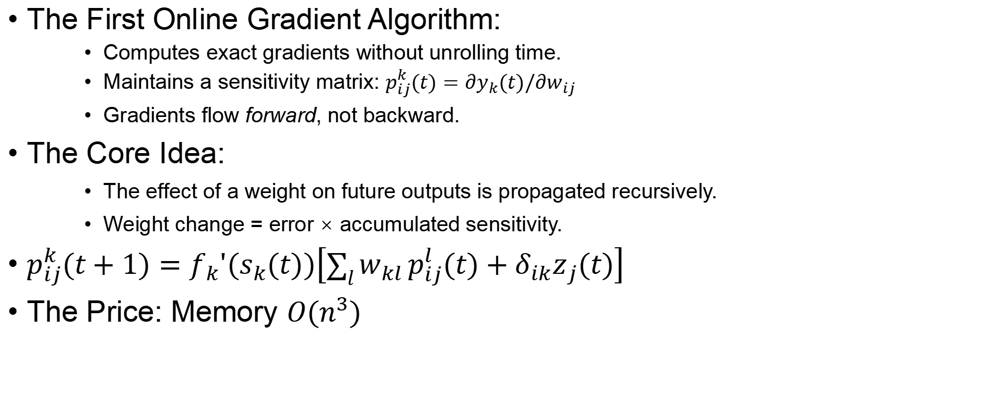
Represent Work—RTRL Real-Time Recurrent Learning
The First Online Gradient Algorithm:
Computes exact gradients without unrolling time.
Maintains a sensitivity matrix: $p_{ij}^{k}(t)=∂y_{k}(t)/∂w_{ij}$
Gradients flow forward, not backward.
The Core Idea:
The effect of a weight on future outputs is propagated recursively.
Weight change = error × accumulated sensitivity.
$p_{ij}^{k}(t+1)=f_{k}'(s_{k}(t))\left[\sum_{l}{w_{kl}}p_{ij}^{l}(t)+δ_{ik}z_{j}(t)\right]$
The Price: Memory $O(n^{3})$

Slide 13
Represent Work—e-Prop
Bridging Neuroscience and Machine Learning:
The brain doesn’t use BPTT, yet learns long-term dependencies.
e-prop’s insight: let error signals meet historical traces in the present.
How It Works:
Eligibility traces carry the past forward.
Learning signals (errors) arrive from the top.
Weight update = learning signal × eligibility trace.

Slide 14
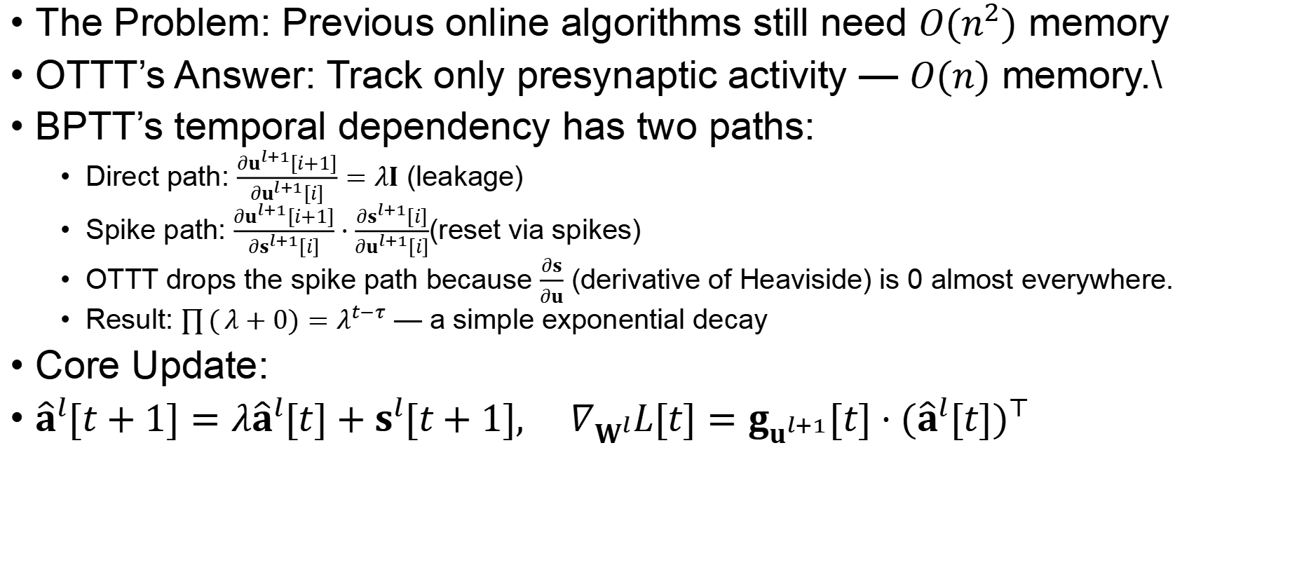
Represent Work—OTTT(Online Training Through Time)
The Problem: Previous online algorithms still need $O(n^{2})$ memory
OTTT’s Answer: Track only presynaptic activity — $O(n)$ memory.\
BPTT’s temporal dependency has two paths:
Direct path: $\frac{∂u^{l+1}[i+1]}{∂u^{l+1}[i]}=λI$ (leakage)
Spike path: $\frac{∂u^{l+1}[i+1]}{∂s^{l+1}[i]}⋅\frac{∂s^{l+1}[i]}{∂u^{l+1}[i]}$(reset via spikes)
OTTT drops the spike path because $\frac{∂s}{∂u}$ (derivative of Heaviside) is 0 almost everywhere.
Result: $\prod{(}λ+0)=λ^{t−τ}$ — a simple exponential decay
Core Update:
${\hat{a}}^{l}[t+1]=λ{\hat{a}}^{l}[t]+s^{l}[t+1], ∇_{W^{l}}L[t]=g_{u^{l+1}}[t]⋅({\hat{a}}^{l}[t])^{⊤}$

Slide 15
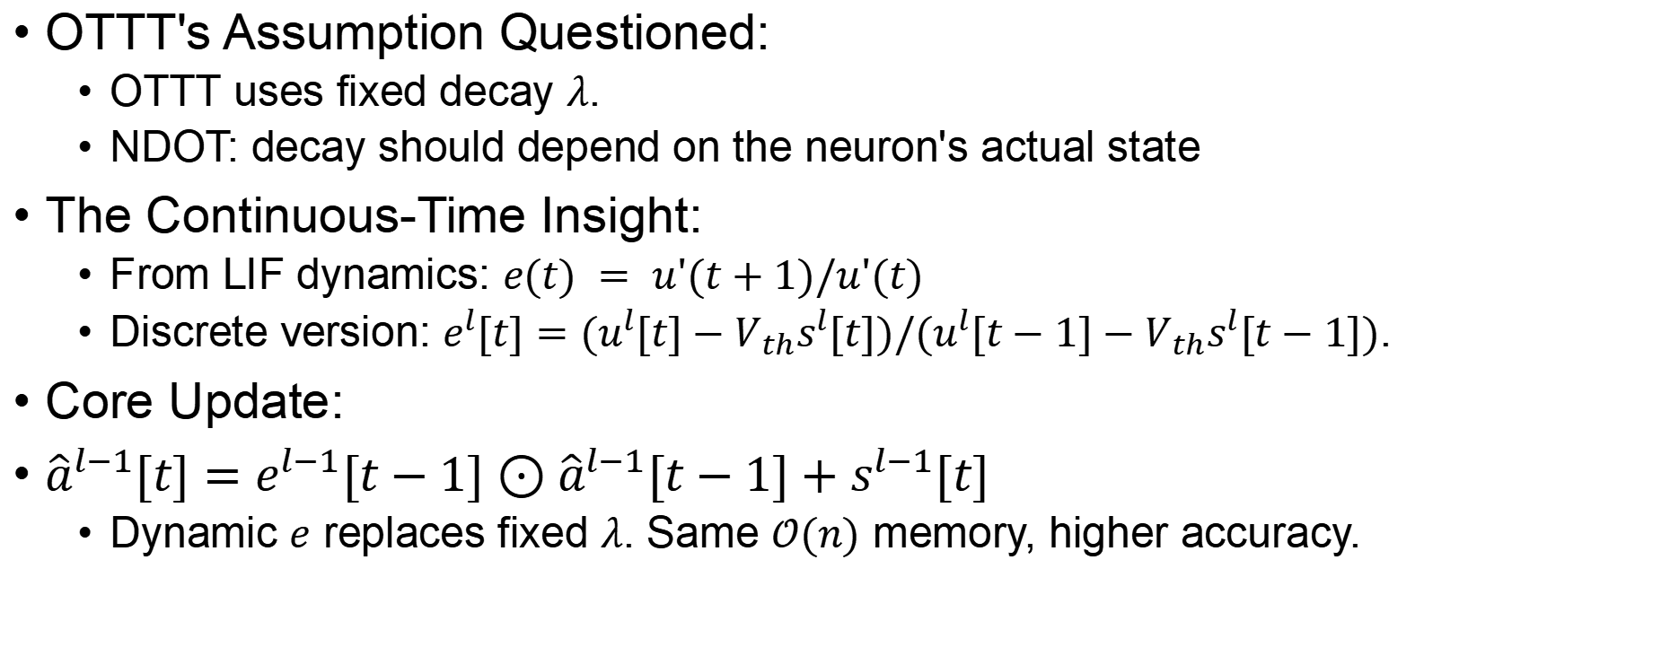
Represent Work—NDOT(Neuronal Dynamics-based Online Training)
OTTT's Assumption Questioned:
OTTT uses fixed decay $λ$.
NDOT: decay should depend on the neuron's actual state
The Continuous-Time Insight:
From LIF dynamics: $e(t) = u'(t+1)/u'(t)$
Discrete version: $e^{l}[t]=(u^{l}[t]−V_{th}s^{l}[t])/(u^{l}[t−1]−V_{th}s^{l}[t−1])$.
Core Update:
${\hat{a}}^{l−1}[t]=e^{l−1}[t−1]⊙{\hat{a}}^{l−1}[t−1]+s^{l−1}[t]$
Dynamic $e$ replaces fixed $λ$. Same $𝒪(n)$ memory, higher accuracy.

Slide 16
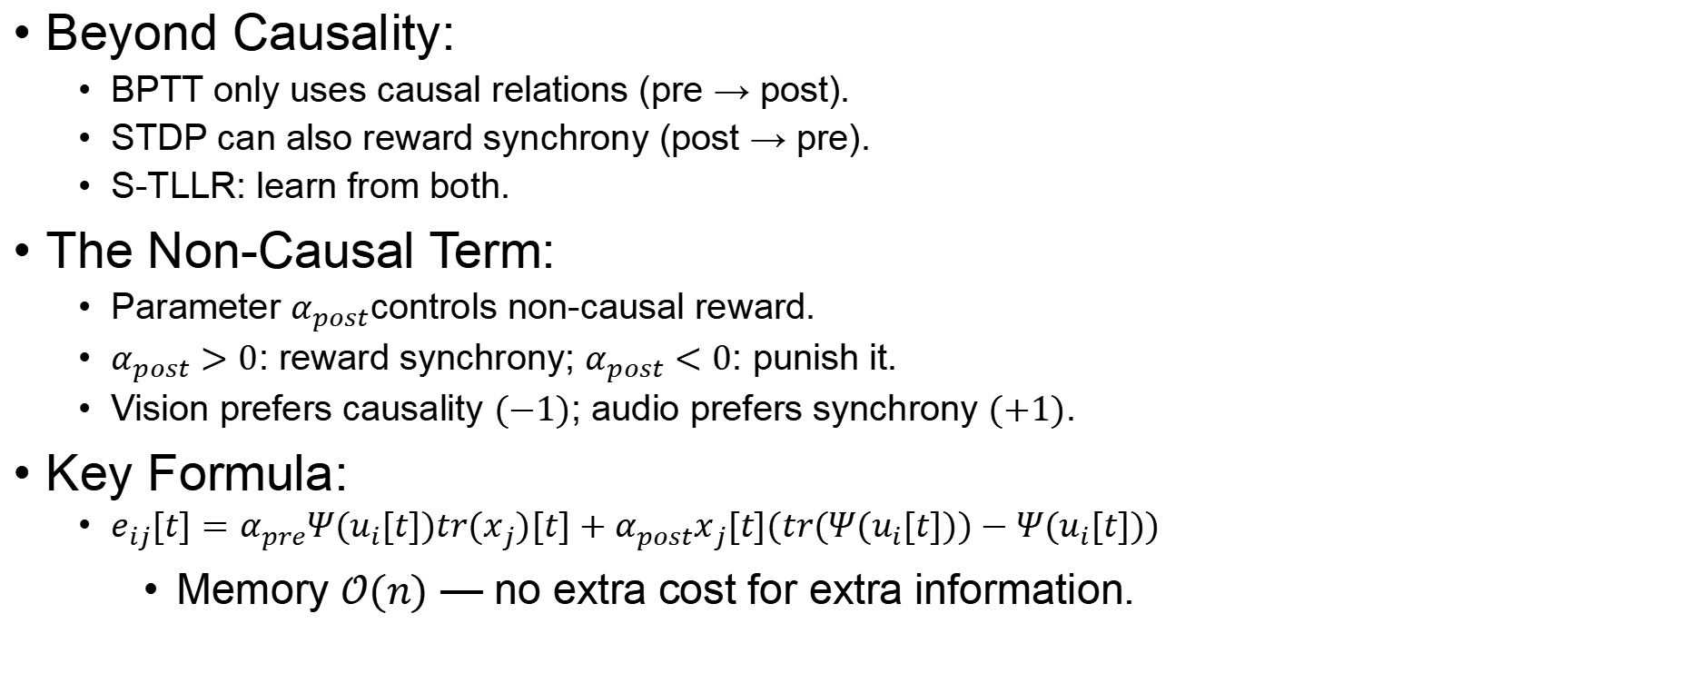
Represent Work—S-TLLR: STDP-inspired Temporal Local Learning Rule for Spiking Neural Networks
Beyond Causality:
BPTT only uses causal relations (pre → post).
STDP can also reward synchrony (post → pre).
S-TLLR: learn from both.
The Non-Causal Term:
Parameter $α_{post}$controls non-causal reward.
$α_{post}>0$: reward synchrony; $α_{post}<0$: punish it.
Vision prefers causality $(−1)$; audio prefers synchrony $(+1)$.
Key Formula:
$e_{ij}[t]=α_{pre}Ψ(u_{i}[t])tr(x_{j})[t]+α_{post}x_{j}[t](tr(Ψ(u_{i}[t]))−Ψ(u_{i}[t]))$
Memory $𝒪(n)$ — no extra cost for extra information.
Notes:
BPTT remembers every timestep and computes gradients later; Online Learning summarizes the past into an eligibility trace and updates weights immediately.

Slide 17
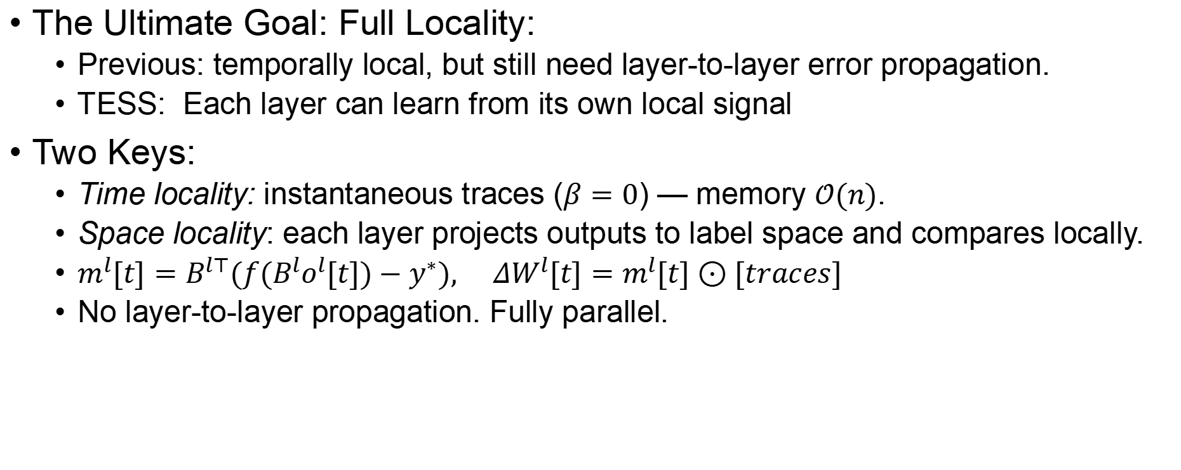
Represent Work—TESS: Temporally and Spatially Local Learning Rule for Spiking Neural Networks
The Ultimate Goal: Full Locality:
Previous: temporally local, but still need layer-to-layer error propagation.
TESS: Each layer can learn from its own local signal
Two Keys:
Time locality: instantaneous traces ($β=0$) — memory $𝒪(n)$.
Space locality: each layer projects outputs to label space and compares locally.
$m^{l}[t]=B^{l⊤}(f(B^{l}o^{l}[t])−y^{∗}), ΔW^{l}[t]=m^{l}[t]⊙[traces]$
No layer-to-layer propagation. Fully parallel.
Notes:
BPTT remembers every timestep and computes gradients later; Online Learning summarizes the past into an eligibility trace and updates weights immediately.

Slide 18
Discussion Questions
Exact vs. Approximate:
RTRL is exact but expensive. OTTT/TESS are approximate but efficient. When would you choose each?
Biology-Inspired vs. Performance:
e-prop and S-TLLR incorporate biological mechanisms. Do these help performance, or are they just constraints?
The Future of Local Learning:
TESS proves full locality is possible. Can it scale to ImageNet-level tasks?

Slide 19
Key Takeaways
Shared Foundation: All algorithms follow the same principle — a learning signal meets an eligibility trace. The difference lies in how each algorithm obtains these two signals.
RTRL (1989): The first online gradient algorithm. Exact but incredibly expensive — requires tracking sensitivity for every weight-output pair.
e-prop (2020): Added biological plausibility through slow ALIF neurons. These variables carry information across long time spans.
OTTT (2022): Discovered that most of BPTT's temporal complexity can be safely ignored. The remaining part is just exponential decay. Memory becomes independent of sequence length.
NDOT (2024): Replaced OTTT's fixed decay with a dynamic one based on actual neuron states. More accurate credit assignment with the same low memory.
S-TLLR (2025): Broke BPTT's causality-only assumption. Added non-causal STDP terms. Different tasks prefer different settings — vision likes causality, audio likes synchrony.
TESS (2025): The ultimate goal achieved. No layer-to-layer error propagation. Each layer learns from locally generated signals. Fully parallelizable and hardware-friendly.

